Slide 1

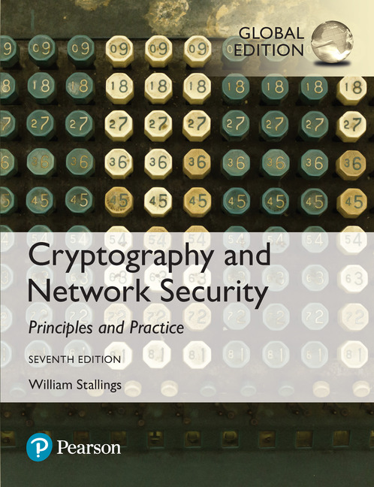
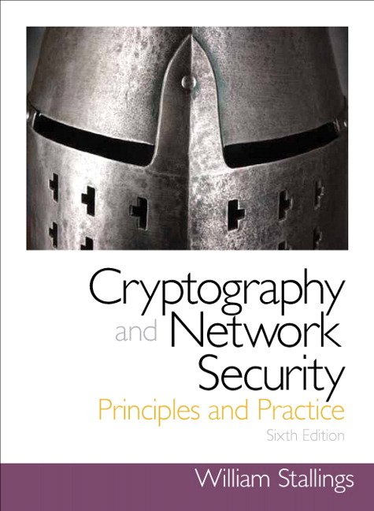
Cryptography and Network Security
Seventh Edition, Global Edition
by William Stallings
Notes:
Lecture slides prepared for “Cryptography and Network Security”, 7/e, by William Stallings, Chapter 7 – “Block Cipher Operation”.

Slide 2
Chapter 5
Block Cipher Operation
Notes:
This chapter continues our discussion of symmetric ciphers. We begin with the topic of
multiple encryption, looking in particular at the most widely used multiple-encryption
scheme: triple DES.
The chapter next turns to the subject of block cipher modes of operation. We
find that there are a number of different ways to apply a block cipher to plaintext, each
with its own advantages and particular applications.

Slide 3
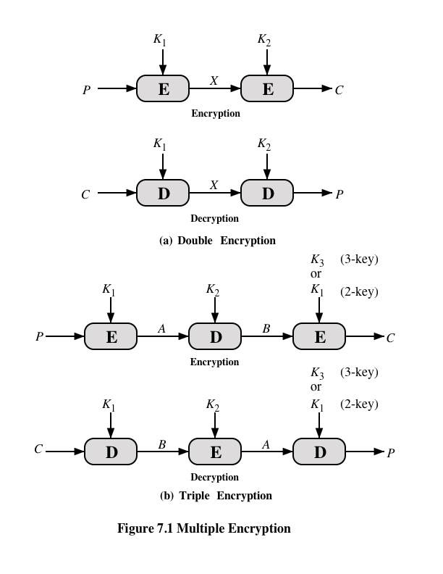
Notes:
Because of its vulnerability to brute-force attack, DES, once the most widely used
symmetric cipher, has been largely replaced by stronger encryption schemes. Two
approaches have been taken. One approach is to design a completely new algorithm
that is resistant to both cryptanalytic and brute-force attacks, of which AES
is a prime example. Another alternative, which preserves the existing investment in
software and equipment, is to use multiple encryption with DES and multiple keys.
We begin by examining the simplest example of this second alternative. We then
look at the widely accepted triple DES (3DES) algorithm.
The simplest form of multiple encryption has two encryption stages and two keys
(Figure 7.1a).
Given a plaintext P and two encryption keys K₁ and K₂ , ciphertext C
is generated as
C = E(K₂ , E(K₁ , P ))
Decryption requires that the keys be applied in reverse order:
P = D(K₁ , D(K₂ , C ))
For DES, this scheme apparently involves a key length of 56 * 2 = 112 bits, resulting
in a dramatic increase in cryptographic strength. But we need to examine the
algorithm more closely.
it is reasonable to assume that if DES is used twice with different keys, it
will produce one of the many mappings that are not defined by a single application
of DES. Although there was much supporting evidence for this assumption, it was
not until 1992 that the assumption was proven [CAMP92].

Slide 4
Meet-in-the-Middle Attack
The use of double DES results in a mapping that is not equivalent to a single DES encryption
The meet-in-the-middle attack algorithm will attack this scheme and does not depend on any particular property of DES but will work against any block encryption cipher
Notes:
Thus, the use of double DES results in a mapping
that is not equivalent to a single DES encryption. But there is a way to attack this
scheme, one that does not depend on any particular property of DES but that will
work against any block encryption cipher.
The algorithm, known as a meet-in-the-middle attack , was first described in
[DIFF77].

Slide 5
Triple-DES with Two-Keys
Obvious counter to the meet-in-the-middle attack is to use three stages of encryption with three different keys
This raises the cost of the meet-in-the-middle attack to 2¹¹², which is beyond what is practical
Has the drawback of requiring a key length of 56 x 3 = 168 bits, which may be somewhat unwieldy
As an alternative Tuchman proposed a triple encryption method that uses only two keys
3DES with two keys is a relatively popular alternative to DES and has been adopted for use in the key management standards ANSI X9.17 and ISO 8732
Notes:
An obvious counter to the meet-in-the-middle attack is to use three stages of encryption
with three different keys. This raises the cost of the meet-in-the-middle attack
to 2¹¹² , which is beyond what is practical now and far into the future. However, it
has the drawback of requiring a key length of 56 * 3 = 168 bits, which may be
somewhat unwieldy.
As an alternative, Tuchman (DES project manager at IBM ), proposed a triple encryption method that uses
only two keys [TUCH79].
3DES with two keys is a relatively popular alternative to DES and has been
adopted for use in the key management standards ANSI X9.17 and ISO 8732.1

Slide 6
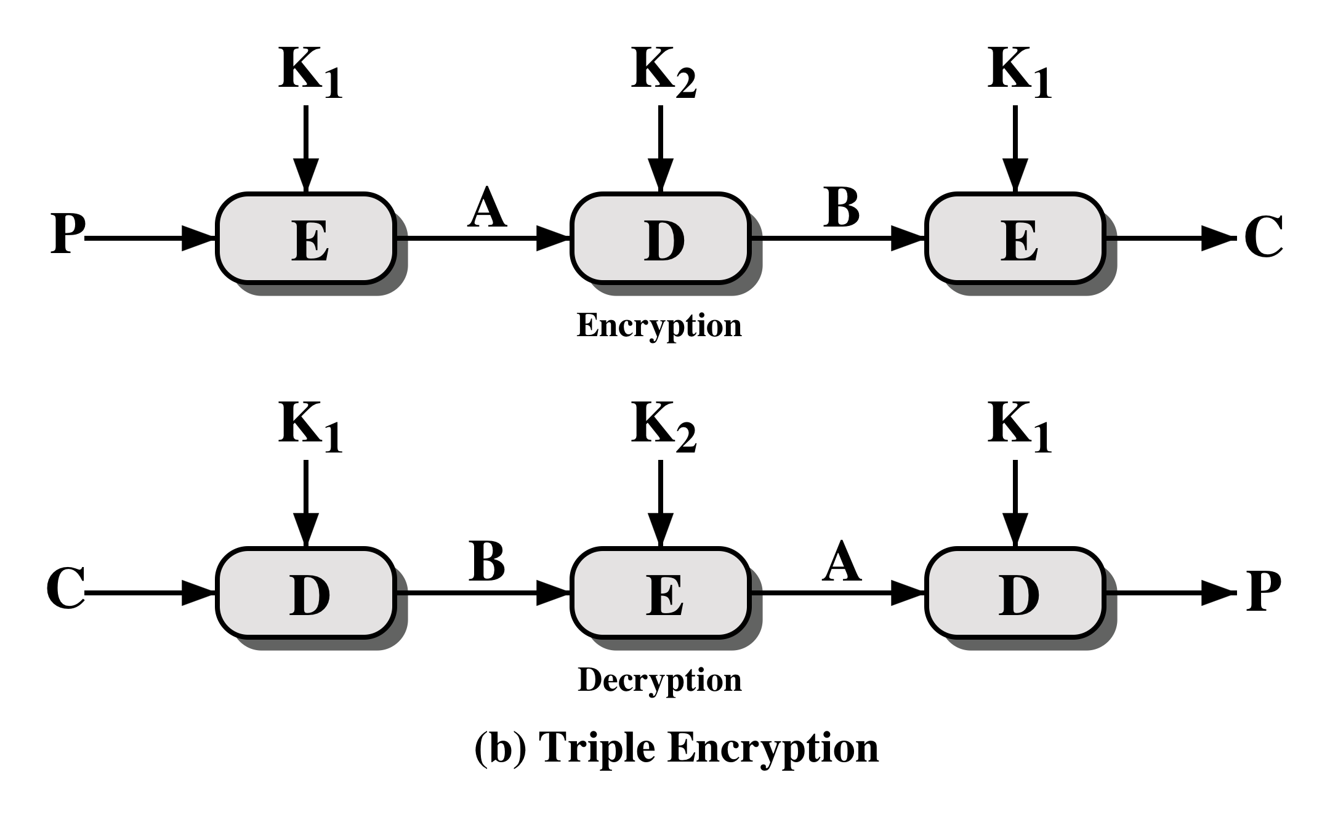
Notes:
The first serious proposal came from Merkle and Hellman [MERK81]. Their
plan involves finding plaintext values that produce a first intermediate value of
A = 0 (Figure 7.1b) and then using the meet-in-the-middle attack to determine
the two keys. The level of effort is 2⁵⁶ , but the technique requires 2⁵⁶ chosen plaintext–
ciphertext pairs, which is a number unlikely to be provided by the holder of
the keys.
A known-plaintext attack is outlined in [VANO90]. This method is an improvement
over the chosen-plaintext approach but requires more effort. The attack
is based on the observation that if we know A and C (Figure 7.1b), then the problem
reduces to that of an attack on double DES. Of course, the attacker does not know
A , even if P and C are known, as long as the two keys are unknown. However, the
attacker can choose a potential value of A and then try to find a known (P , C ) pair
that produces A .

Slide 7
Triple DES with Three Keys
Many researchers now feel that three-key 3DES is the preferred alternative
A number of Internet-based applications have adopted three-key 3DES including PGP and S/MIME
Three-key 3DES has an effective key length of 168 bits and is defined as:
C = E( K₃, D( K₂, E( K₁, P)))
Backward compatibility with DES is provided by putting:
K₃ = K₂ or K₁ = K₂
Notes:
Although the attacks just described appear impractical, anyone using two-key 3DES
may feel some concern. Thus, many researchers now feel that three-key 3DES is
the preferred alternative (e.g., [KALI96a]). Three-key 3DES has an effective key
length of 168 bits and is defined as
C = E( K₃, D( K₂, E( K₁, P)))
Backward compatibility with DES is provided by putting
K₃ = K₂ or K₁ = K₂
A number of Internet-based applications have adopted three-key 3DES, including
PGP and S/MIME, both discussed in Chapter 19.
PGP is short for Pretty Good Privacy, a security program that enables users to communicate securely by decrypting and encrypting messages, authenticating messages through digital signatures, and encrypting files.

Slide 8
Modes of Operation
A technique for enhancing the effect of a cryptographic algorithm or adapting the algorithm for an application
To apply a block cipher in a variety of applications, five modes of operation have been defined by NIST
The five modes are intended to cover a wide variety of applications of encryption for which a block cipher could be used
These modes are intended for use with any symmetric block cipher, including triple DES and AES
Notes:
A block cipher takes a fixed-length block of text of length b bits and a key as input
and produces a b -bit block of ciphertext. If the amount of plaintext to be encrypted
is greater than b bits, then the block cipher can still be used by breaking the plaintext
up into b -bit blocks. When multiple blocks of plaintext are encrypted using the
same key, a number of security issues arise. To apply a block cipher in a variety of
applications, five modes of operation have been defined by NIST (SP 800-38A).
In essence, a mode of operation is a technique for enhancing the effect of a cryptographic
algorithm or adapting the algorithm for an application, such as applying
a block cipher to a sequence of data blocks or a data stream. The five modes are
intended to cover a wide variety of applications of encryption for which a block
cipher could be used. These modes are intended for use with any symmetric block
cipher, including triple DES and AES.

Slide 9
Electronic Codebook Mode
It is one of the simplest modes of operation. In this mode, the plain text is divided into a block where each block is 64 bits. Then each block is encrypted separately. The same key is used for the encryption of all blocks.
As the same key used for tor all block, to avoid the repetition of block, ECB mode is used for an only small message where the repetition of the plain text block is less.

Slide 10
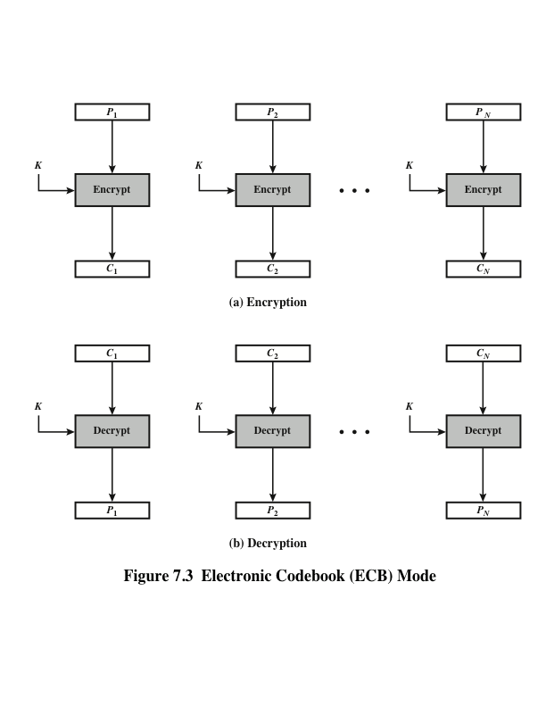
Notes:
The simplest mode is the electronic codebook (ECB ) mode, in which plaintext
is handled one block at a time and each block of plaintext is encrypted using the
same key (Figure 7.3). The term codebook is used because, for a given key, there is
a unique ciphertext for every b -bit block of plaintext. Therefore, we can imagine a
gigantic codebook in which there is an entry for every possible b -bit plaintext pattern
showing its corresponding ciphertext.
For a message longer than b bits, the procedure is simply to break the message
into b -bit blocks, padding the last block if necessary. Decryption is performed one
block at a time, always using the same key. In Figure 7.3, the plaintext (padded as
necessary) consists of a sequence of b -bit blocks, P₁ , P₂ , . . . , P_{N} ; the corresponding
sequence of ciphertext blocks is C₁ , C₂ , . . . , C_{N} . We can define ECB mode as
follows.
ECB C_{j} = E(K, Pj) j = 1, . . . , N P_{j} = D(K, Cj₎ j = 1, . . . , N
The ECB method is ideal for a short amount of data, such as an encryption
key. Thus, if you want to transmit a DES or AES key securely, ECB is the appropriate
mode to use.
The most significant characteristic of ECB is that if the same b -bit block of
plaintext appears more than once in the message, it always produces the same
ciphertext.
For lengthy messages, the ECB mode may not be secure. If the message is
highly structured, it may be possible for a cryptanalyst to exploit these regularities.
For example, if it is known that the message always starts out with certain
predefined fields, then the cryptanalyst may have a number of known plaintext–
ciphertext pairs to work with. If the message has repetitive elements with a
period of repetition a multiple of b bits, then these elements can be identified by the
analyst. This may help in the analysis or may provide an opportunity for substituting
or rearranging blocks.

Slide 11
Electronic Codebook Mode
Advantages of using ECB
Parallel encryption of blocks of bits is possible, thus it is a faster way of encryption.
Simple way of the block cipher.
Disadvantages of using ECB
Prone to cryptanalysis since there is a direct relationship between plaintext and ciphertext.
Uses: Secure transmission of single values

Slide 12
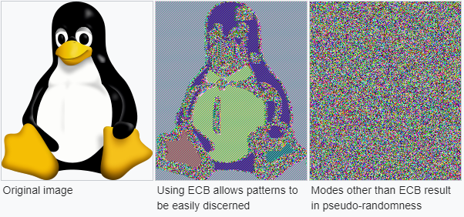
Electronic Codebook Mode

Slide 13

Criteria and properties for evaluating and constructing block cipher modes of operation that are superior to ECB:
Overhead
Error recovery
Error propagation
Diffusion
Security
Notes:
We now turn to more complex modes of operation. [KNUD00] lists the following
criteria and properties for evaluating and constructing block cipher modes of
operation that are superior to ECB:
• Overhead: The additional operations for the encryption and decryption
operation when compared to encrypting and decrypting in the ECB mode.
• Error recovery: The property that an error in the i th ciphertext block is inherited
by only a few plaintext blocks after which the mode resynchronizes.
• Error propagation: The property that an error in the i th ciphertext block is
inherited by the i th and all subsequent plaintext blocks. What is meant here is
a bit error that occurs in the transmission of a ciphertext block, not a computational
error in the encryption of a plaintext block.
• Diffusion: How the plaintext statistics are reflected in the ciphertext. Low
entropy plaintext blocks should not be reflected in the ciphertext blocks.
Roughly, low entropy equates to predictability or lack of randomness (see
Appendix F).
• Security: Whether or not the ciphertext blocks leak information about the
plaintext blocks.

Slide 14
Cipher Block Chaining Mode
The plain text is divided into blocks. In this mode, IV(Initialization Vector) is used, which can be a random block of text. IV is used to make the ciphertext of each block unique.
The first block of plain text and IV is combined using the XOR operation and then encrypted using the key and form the first block of ciphertext.
The first ciphertext block is used as IV for the second block of plain text. The same procedure will be followed for all blocks of plain text.
Notes:
In CBC, the previous cipher block is given as input to the next encryption algorithm after XOR with the original plaintext block. In a nutshell here, a cipher block is produced by encrypting an XOR output of the previous cipher block and present plaintext block.

Slide 15
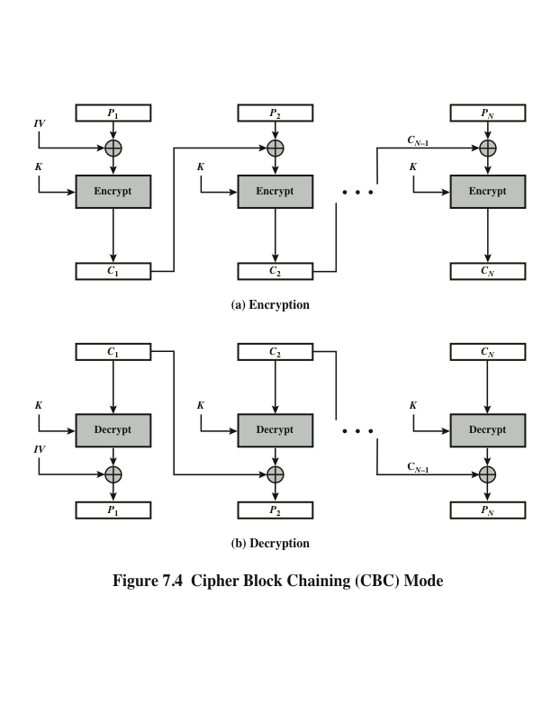
Notes:
To overcome the security deficiencies of ECB, we would like a technique in which
the same plaintext block, if repeated, produces different ciphertext blocks. A
simple way to satisfy this requirement is the cipher block chaining (CBC ) mode
(Figure 7.4). In this scheme, the input to the encryption algorithm is the XOR of the
current plaintext block and the preceding ciphertext block; the same key is used for
each block. In effect, we have chained together the processing of the sequence of
plaintext blocks. The input to the encryption function for each plaintext block bears
no fixed relationship to the plaintext block. Therefore, repeating patterns of b bits
are not exposed. As with the ECB mode, the CBC mode requires that the last block
be padded to a full b bits if it is a partial block.
For decryption, each cipher block is passed through the decryption algorithm.
The result is XORed with the preceding ciphertext block to produce the plaintext
block.
To produce the first block of ciphertext, an initialization vector (IV) is XORed
with the first block of plaintext. On decryption, the IV is XORed with the output
of the decryption algorithm to recover the first block of plaintext. The IV is a data
block that is the same size as the cipher block.
The IV must be known to both the sender and receiver but be unpredictable
by a third party. In particular, for any given plaintext, it must not be possible to
predict the IV that will be associated to the plaintext in advance of the generation
of the IV. For maximum security, the IV should be protected against unauthorized
changes. This could be done by sending the IV using ECB encryption. One reason
for protecting the IV is as follows: If an opponent is able to fool the receiver into
using a different value for IV, then the opponent is able to invert selected bits in the
first block of plaintext.
So long as it is unpredictable, the specific choice of IV is unimportant.
SP800-38A recommends two possible methods: The first method is to apply the
encryption function, under the same key that is used for the encryption of the plaintext,
to a nonce . The nonce must be a data block that is unique to each execution of
the encryption operation. For example, the nonce may be a counter, a timestamp, or
a message number. The second method is to generate a random data block using a
random number generator.
In conclusion, because of the chaining mechanism of CBC, it is an appropriate
mode for encrypting messages of length greater than b bits.
In addition to its use to achieve confidentiality, the CBC mode can be used for
authentication. This use is described in Chapter 12.

Slide 16
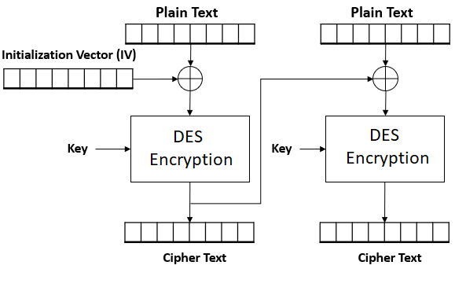
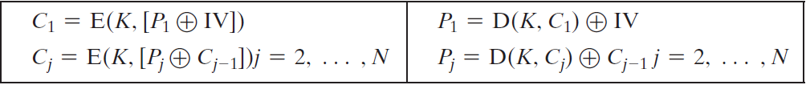
Cipher Block Chaining Mode
Notes:
In CBC, the previous cipher block is given as input to the next encryption algorithm after XOR with the original plaintext block. In a nutshell here, a cipher block is produced by encrypting an XOR output of the previous cipher block and present plaintext block.

Slide 17
Cipher Block Chaining Mode
Advantages of CBC
CBC works well for input greater than b bits.
CBC is a good authentication mechanism.
Better resistance towards cryptanalysis than ECB.
Disadvantages of CBC
Parallel encryption is not possible since every encryption requires a previous cipher.
Uses: bulk data encryption, authentication.

Slide 18
Feedback Modes
It is possible to convert a block cipher into a stream cipher, using one of the three modes:
Cipher Feedback (CFB) mode
Output Feedback (OFB) mode
Counter (CTR) mode
A stream cipher eliminates the need to pad a message to be an integral number of blocks. It also can operate in real time.

Slide 19
Cipher Feedback Mode
In this mode the cipher is given as feedback to the next block of encryption with some new specifications:
first, an initial vector IV is used for first encryption and output bits are divided as a set of s and b-s bits.
The left-hand side s bits are selected along with plaintext bits to which an XOR operation is applied. The result is given as input to a shift register having b-s bits to lhs, s bits to rhs and the process continues.

Slide 20
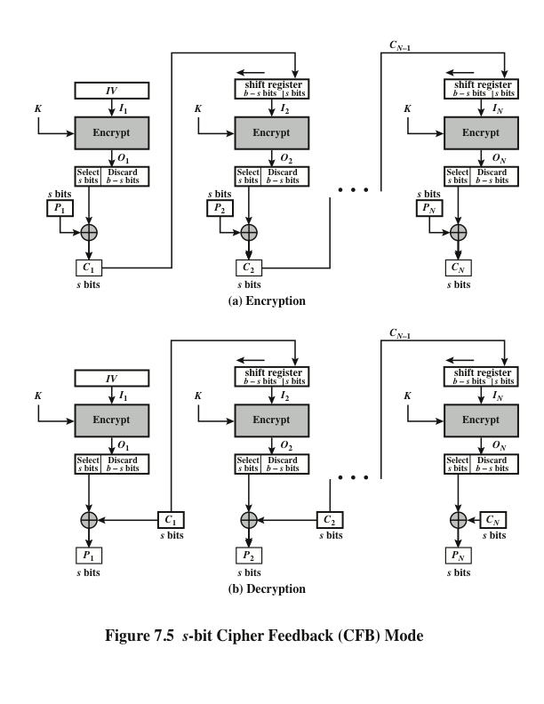
Notes:
Figure 7.5 depicts the CFB scheme. In the figure, it is assumed that the unit of
transmission is s bits; a common value is s = 8. As with CBC, the units of plaintext
are chained together, so that the ciphertext of any plaintext unit is a function of all
the preceding plaintext. In this case, rather than blocks of b bits, the plaintext is
divided into segments of s bits.
First, consider encryption. The input to the encryption function is a b -bit shift
register that is initially set to some initialization vector (IV). The leftmost (most
significant) s bits of the output of the encryption function are XORed with the
first segment of plaintext P₁ to produce the first unit of ciphertext C₁ , which is then
transmitted. In addition, the contents of the shift register are shifted left by s bits,
and C₁ is placed in the rightmost (least significant) s bits of the shift register. This
process continues until all plaintext units have been encrypted.
For decryption, the same scheme is used, except that the received ciphertext
unit is XORed with the output of the encryption function to produce the plaintext
unit. Note that it is the encryption function that is used, not the decryption function.
Although CFB can be viewed as a stream cipher, it does not conform to the
typical construction of a stream cipher. In a typical stream cipher, the cipher takes
as input some initial value and a key and generates a stream of bits, which is then
XORed with the plaintext bits (see Figure 4.1). In the case of CFB, the stream of
bits that is XORed with the plaintext also depends on the plaintext.
In CFB encryption, like CBC encryption, the input block to each forward
Cipher function (except the first) depends on the result of the previous forward
Cipher function; therefore, multiple forward cipher operations cannot be performed
in parallel. In CFB decryption, the required forward cipher operations can be performed
in parallel if the input blocks are first constructed (in series) from the IV and
the ciphertext.

Slide 21
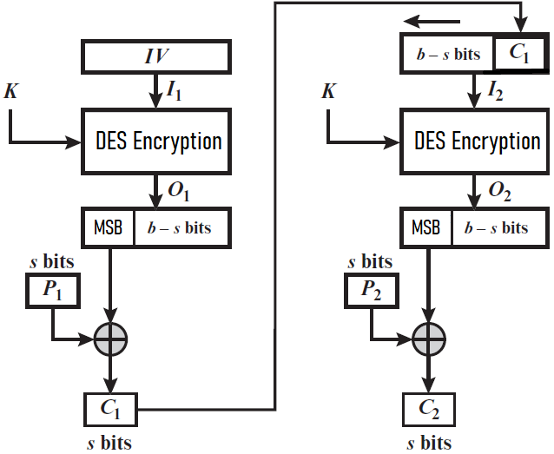
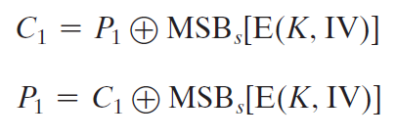
Cipher Feedback Mode

Slide 22
Cipher Feedback Mode
Advantages of CFB
Since, there is some data loss due to the use of shift register, thus it is difficult for applying cryptanalysis.
Disadvantages of using CFB
The drawbacks of CFB are the same as those of CBC mode. Parallel encryption is not possible since every encryption requires a previous cipher.
Uses: stream data encryption, authentication

Slide 23
Output Feedback Mode
OFB mode is similar to CFB mode; the only difference is in CFB, the ciphertext is used for the next stage of the encryption process, whereas in OFB, the output of the IV encryption is used for the next stage of the encryption process. The same procedure is followed for all blocks.
Notes:
In this output feedback mode, all bits of the block are sent instead of sending selected s bits. The Output Feedback mode of block cipher holds great resistance towards bit transmission errors. It also decreases the dependency or relationship of the cipher on the plaintext.

Slide 24
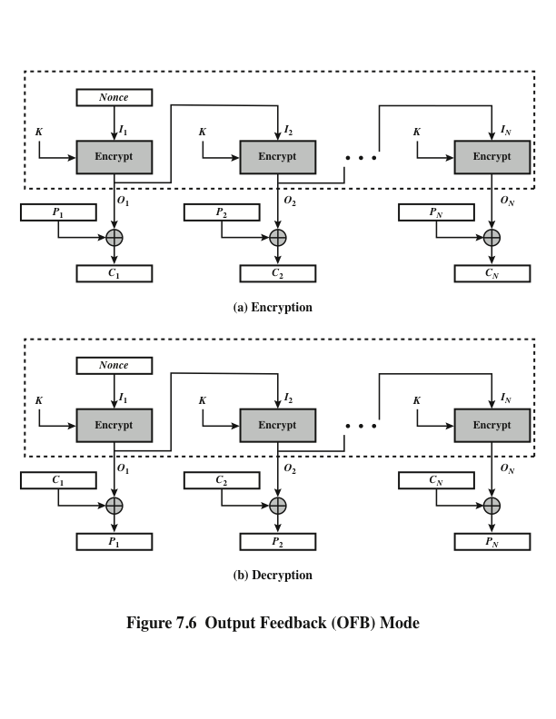
Notes:
The output feedback (OFB) mode is similar in structure to that of CFB. For OFB,
the output of the encryption function is fed back to become the input for encrypting
the next block of plaintext (Figure 7.6). In CFB, the output of the XOR unit is fed
back to become input for encrypting the next block. The other difference is that the
OFB mode operates on full blocks of plaintext and ciphertext, whereas CFB operates
on an s -bit subset.
As with CBC and CFB, the OFB mode requires an initialization vector. In
the case of OFB, the IV must be a nonce; that is, the IV must be unique to each
execution of the encryption operation. The reason for this is that the sequence of
encryption output blocks, O_{i} , depends only on the key and the IV and does not depend
on the plaintext. Therefore, for a given key and IV, the stream of output bits
used to XOR with the stream of plaintext bits is fixed. If two different messages had
an identical block of plaintext in the identical position, then an attacker would be
able to determine that portion of the O_{i} stream.
One advantage of the OFB method is that bit errors in transmission do not
propagate. For example, if a bit error occurs in C₁ , only the recovered value of P₁ is
affected; subsequent plaintext units are not corrupted. With CFB, C₁ also serves as
input to the shift register and therefore causes additional corruption downstream.
The disadvantage of OFB is that it is more vulnerable to a message stream
modification attack than is CFB. Consider that complementing a bit in the ciphertext
complements the corresponding bit in the recovered plaintext. Thus, controlled
changes to the recovered plaintext can be made. This may make it possible for an
opponent, by making the necessary changes to the checksum portion of the message
as well as to the data portion, to alter the ciphertext in such a way that it is not detected
by an error-correcting code. For a further discussion, see [VOYD83].
OFB has the structure of a typical stream cipher, because the cipher generates
a stream of bits as a function of an initial value and a key, and that stream of
bits is XORed with the plaintext bits (see Figure 4.1). The generated stream that is
XORed with the plaintext is itself independent of the plaintext; this is highlighted
by dashed boxes in Figure 7.6. One distinction from the stream ciphers we discuss
in Chapter 8 is that OFB encrypts plaintext a full block at a time, where typically a
block is 64 or 128 bits. Many stream ciphers encrypt one byte at a time.

Slide 25
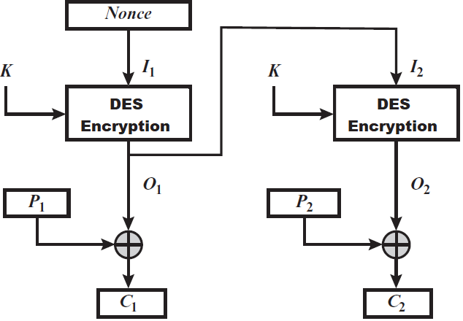
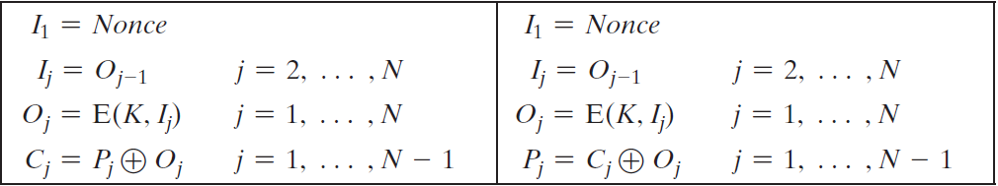
Output Feedback Mode
Notes:
A Message Stream Modification Attack is a type of attack where an adversary intercepts and alters the content of a communication stream between two parties without their knowledge. This attack can involve modifying, deleting, or reordering messages to create misleading or false information.
Output Feedback (OFB) mode is more sensitive to a message stream modification attack compared to Cipher Feedback (CFB) mode because OFB generates keystream blocks independently of the plaintext and applies them directly to the plaintext or ciphertext. This means that if an attacker modifies a bit in the ciphertext, the corresponding bit in the decrypted plaintext will be altered, but the synchronization of the keystream with the message will remain unaffected.
In contrast, CFB mode feeds the ciphertext back into the encryption process, so a modification in the ciphertext can disrupt the decryption of subsequent blocks, potentially alerting the receiver to tampering. This makes CFB mode more resilient to stream modification attacks than OFB mode.

Slide 26
Output Feedback Mode
Advantages of OFB
In the case of CFB, a single bit error in a block is propagated to all subsequent blocks. This problem is solved by OFB as it is free from bit errors in the plaintext block.
Disadvantages of OFB
The drawback of OFB is that it is more sensitive to a message stream modification attack than CFB.
Uses: stream encryption over noisy channels
Notes:
A Message Stream Modification Attack is a type of attack where an adversary intercepts and alters the content of a communication stream between two parties without their knowledge. This attack can involve modifying, deleting, or reordering messages to create misleading or false information.
Output Feedback (OFB) mode is more sensitive to a message stream modification attack compared to Cipher Feedback (CFB) mode because OFB generates keystream blocks independently of the plaintext and applies them directly to the plaintext or ciphertext. This means that if an attacker modifies a bit in the ciphertext, the corresponding bit in the decrypted plaintext will be altered, but the synchronization of the keystream with the message will remain unaffected.
In contrast, CFB mode feeds the ciphertext back into the encryption process, so a modification in the ciphertext can disrupt the decryption of subsequent blocks, potentially alerting the receiver to tampering. This makes CFB mode more resilient to stream modification attacks than OFB mode.

Slide 27
Counter Mode
CTR mode uses the sequence of numbers as an input for the algorithm. When the block is encrypted, to fill the next register, next counter value (incremented by 1) is used.
For encryption, the first counter is encrypted using a key, then, the plain text is XOR with the encrypted result to form the ciphertext.
The counter will be incremented by 1 for the next stage, and the same procedure will be followed for all blocks.

Slide 28
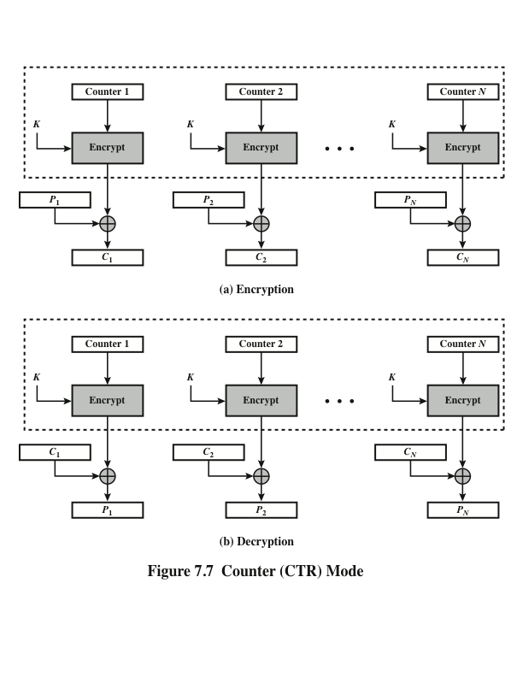
Notes:
Although interest in the counter (CTR) mode has increased recently with applications
to ATM (asynchronous transfer mode) network security and IP sec (IP security),
this mode was proposed early on (e.g., [DIFF79]).
Figure 7.7 depicts the CTR mode. A counter equal to the plaintext block
size is used. The only requirement stated in SP 800-38A is that the counter value
must be different for each plaintext block that is encrypted. Typically, the counter
is initialized to some value and then incremented by 1 for each subsequent block
(modulo 2^{b} , where b is the block size). For encryption, the counter is encrypted and
then XORed with the plaintext block to produce the ciphertext block; there is no
chaining. For decryption, the same sequence of counter values is used, with each encrypted
counter XORed with a ciphertext block to recover the corresponding plaintext
block. Thus, the initial counter value must be made available for decryption.
As with the OFB mode, the initial counter value must be a nonce; that is, T₁
must be different for all of the messages encrypted using the same key. Further,
all T_{i} values across all messages must be unique. If, contrary to this requirement, a
counter value is used multiple times, then the confidentiality of all of the plaintext
blocks corresponding to that counter value may be compromised. In particular, if
any plaintext block that is encrypted using a given counter value is known, then
the output of the encryption function can be determined easily from the associated
ciphertext block. This output allows any other plaintext blocks that are encrypted
using the same counter value to be easily recovered from their associated ciphertext
blocks.
One way to ensure the uniqueness of counter values is to continue to increment
the counter value by 1 across messages. That is, the first counter value of the
each message is one more than the last counter value of the preceding message.

Slide 29
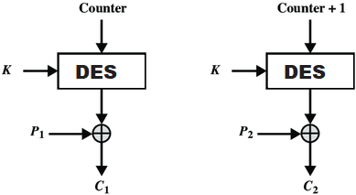
Counter Mode

Slide 30
Counter Mode
Advantages of Counter
Since there is a different counter value for each block, the direct plaintext and ciphertext relationship is avoided. This means that the same plain text can map to different ciphertext.
Parallel execution of encryption is possible as outputs from previous stages are not chained as in the case of CBC.
Disadvantages of Counter
The fact that CTR mode requires a synchronous counter at both the sender and the receiver is a serious drawback. The recovery of plaintext maybe incorrect when synchronization is lost.
Uses: high speed network encryption

Slide 31

Advantages of CTR
Hardware efficiency
Software efficiency
Preprocessing
Random access
Provable security
Simplicity
Notes:
[LIPM00] lists the following advantages of CTR mode.
• Hardware efficiency: Unlike the three chaining modes, encryption (or decryption)
in CTR mode can be done in parallel on multiple blocks of plaintext or
ciphertext. For the chaining modes, the algorithm must complete the computation
on one block before beginning on the next block. This limits the maximum
throughput of the algorithm to the reciprocal of the time for one execution of
block encryption or decryption. In CTR mode, the throughput is only limited
by the amount of parallelism that is achieved.
• Software efficiency: Similarly, because of the opportunities for parallel execution
in CTR mode, processors that support parallel features, such as aggressive
pipelining, multiple instruction dispatch per clock cycle, a large number of
registers, and SIMD instructions, can be effectively utilized.
• Preprocessing: The execution of the underlying encryption algorithm does
not depend on input of the plaintext or ciphertext. Therefore, if sufficient
memory is available and security is maintained, preprocessing can be used to
prepare the output of the encryption boxes that feed into the XOR functions,
as in Figure 6.7. When the plaintext or ciphertext input is presented, then
the only computation is a series of XORs. Such a strategy greatly enhances
throughput.
• Random access: The ith block of plaintext or ciphertext can be processed in
random-access fashion. With the chaining modes, block C_{i} cannot be computed
until the i - 1 prior block are computed. There may be applications in
which a ciphertext is stored and it is desired to decrypt just one block; for such
applications, the random access feature is attractive.
• Provable security: It can be shown that CTR is at least as secure as the other
modes discussed in this section.
• Simplicity: Unlike ECB and CBC modes, CTR mode requires only the implementation
of the encryption algorithm and not the decryption algorithm.
This matters most when the decryption algorithm differs substantially from
the encryption algorithm, as it does for AES. In addition, the decryption key
scheduling need not be implemented.

Slide 32
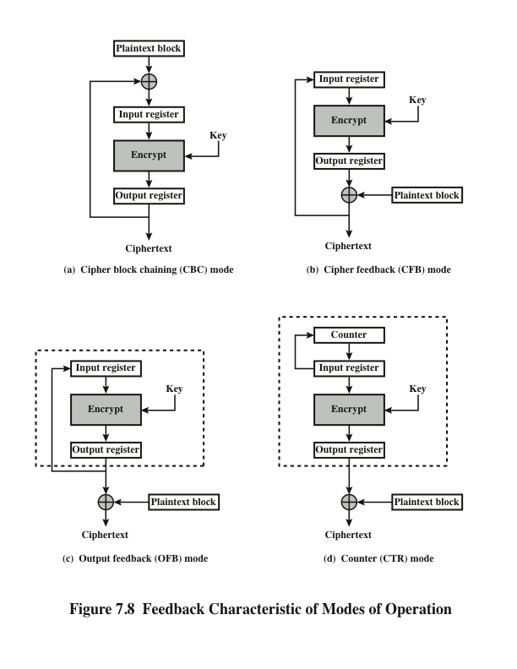
Notes:
Note that, with the exception of ECB, all of the NIST-approved block
cipher modes of operation involve feedback. This is clearly seen in Figure 7.8. To
highlight the feedback mechanism, it is useful to think of the encryption function
as taking input from a input register whose length equals the encryption block
length and with output stored in an output register. The input register is updated
one block at a time by the feedback mechanism. After each update, the encryption
algorithm is executed, producing a result in the output register. Meanwhile,
a block of plaintext is accessed. Note that both OFB and CTR produce output
that is independent of both the plaintext and the ciphertext. Thus, they are natural
candidates for stream ciphers that encrypt plaintext by XOR one full block
at a time.

Slide 33
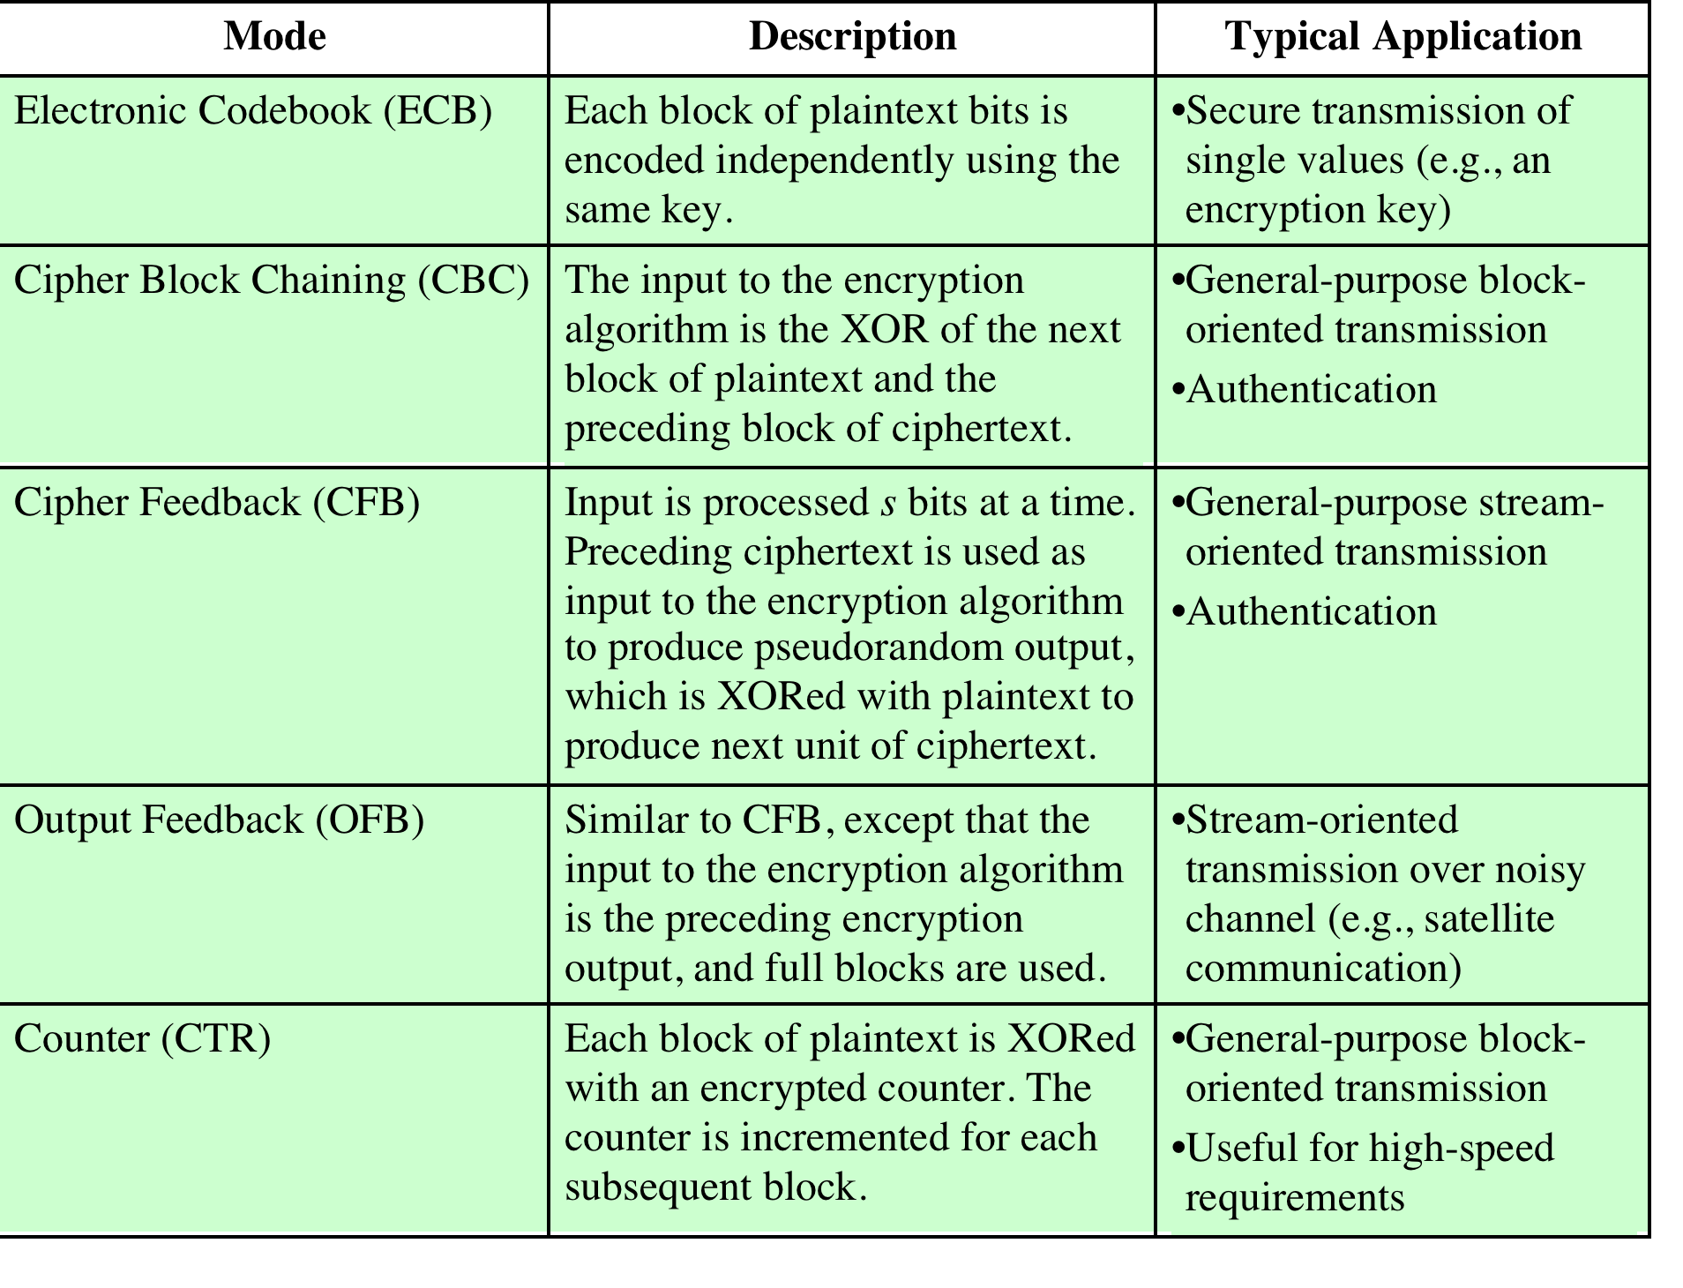
Notes:
The modes are summarized in Table 7.1 and described in this and the following sections.

Slide 34
Additional modes of operations
XTS (Xor Tweakable Block Cipher)
FFE (Format Preserving Encryption)
CMAC (Cipher-based Message Authentication Code)
GCM (Galois/ Counter Mode)

Slide 35
XTS-AES Mode for Block-Oriented Storage Devices
Approved as an additional block cipher mode of operation by NIST in 2010
Mode is also an IEEE Standard, IEEE Std 1619-2007
Standard describes a method of encryption for data stored in sector-based devices where the threat model includes possible access to stored data by the adversary
Has received widespread industry support
Notes:
In 2010, NIST approved an additional block cipher mode of operation, XTS-AES.
This mode is also an IEEE standard, IEEE Std 1619-2007, which was developed
by the IEEE Security in Storage Working Group (P1619). The standard describes
a method of encryption for data stored in sector-based devices where the threat
model includes possible access to stored data by the adversary. The standard has
received widespread industry support.

Slide 36
Tweakable Block Ciphers
XTS-AES mode is based on the concept of a tweakable block cipher
General structure:
Has three inputs:
Tweak need not be kept secret
Purpose is to provide variability
A
plaintext
P
A symmetric key
K
A
tweak
T
Produces
a ciphertext output
C
Notes:
The XTS-AES mode is based on the concept of a tweakable block cipher , introduced
in [LISK02], which functions in much the same manner as a salt used with
passwords, as described in Chapter 22. The form of this concept used in XTS-AES
was first described in [ROGA04].
Before examining XTS-AES, let us consider the general structure of a tweakable
block cipher. A tweakable block cipher is one that has three inputs: a plaintext P ,
a symmetric key K , and a tweak T ; and produces a ciphertext output C . We can
write this as C = E(K , T , P ). The tweak need not be kept secret. Whereas the purpose
of the key is to provide security, the purpose of the tweak is to provide variability.
That is, the use of different tweaks with the same plaintext and same key
produces different outputs.

Slide 37
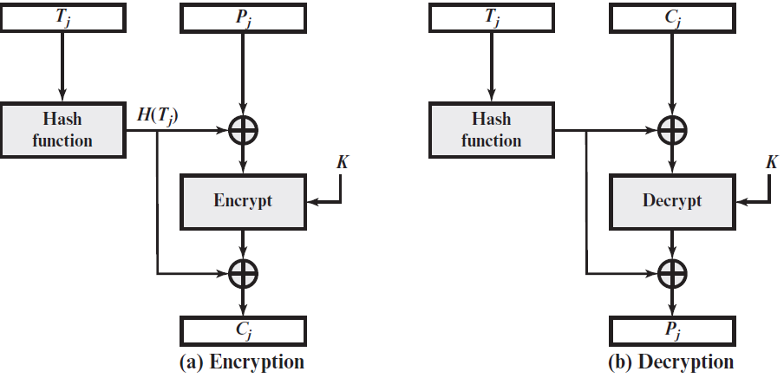
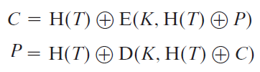
Tweakable Block Ciphers
Notes:
The XTS-AES mode is based on the concept of a tweakable block cipher , introduced
in [LISK02], which functions in much the same manner as a salt used with
passwords, as described in Chapter 22. The form of this concept used in XTS-AES
was first described in [ROGA04].
Before examining XTS-AES, let us consider the general structure of a tweakable
block cipher. A tweakable block cipher is one that has three inputs: a plaintext P ,
a symmetric key K , and a tweak T ; and produces a ciphertext output C . We can
write this as C = E(K , T , P ). The tweak need not be kept secret. Whereas the purpose
of the key is to provide security, the purpose of the tweak is to provide variability.
That is, the use of different tweaks with the same plaintext and same key
produces different outputs.

Slide 38
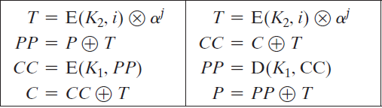
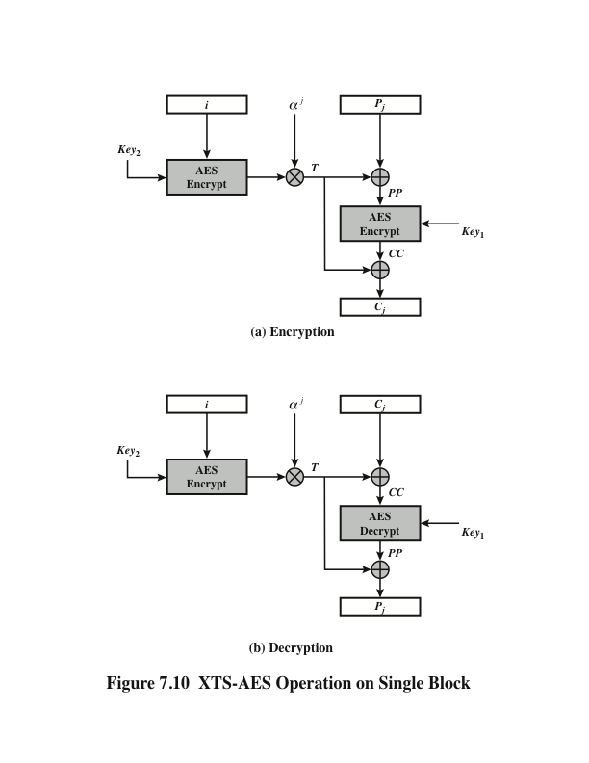
XTS-AES Operation on Single Block
Notes:
Figure 7.10 shows the encryption and decryption of a single block. The operation involves
two instances of the AES algorithm with two keys.
⊗ Modular multiplication

Slide 39
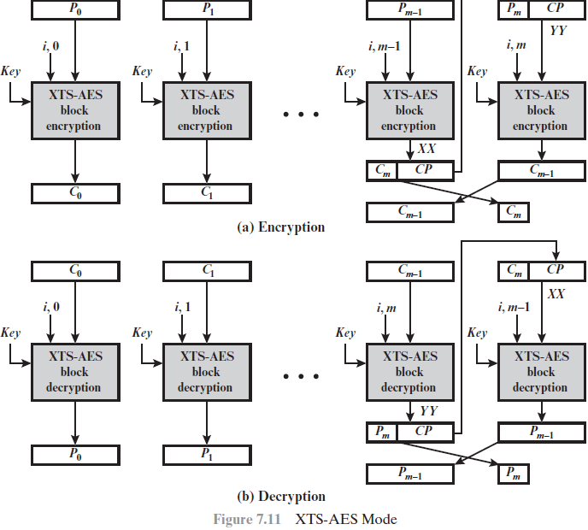
Notes:
The plaintext of a sector or data unit is organized into blocks of 128 bits. Blocks are
labeled P₀ , P₁ , . . . , P_{m} . The last block my be null or may contain from 1 to 127 bits.
In other words, the input to the XTS-AES algorithm consists of m 128-bit blocks
and possibly a final partial block.
As can be seen, XTS-AES mode, like CTR mode, is suitable for parallel operation.
Because there is no chaining, multiple blocks can be encrypted or decrypted
simultaneously. Unlike CTR mode, XTS-AES mode includes a nonce (the parameter
i ) as well as a counter (parameter j ).
For encryption and decryption, each block is treated independently and
encrypted/decrypted as shown in Figure 7.10. The only exception occurs when
the last block has less than 128 bits. In that case, the last two blocks are encrypted/
decrypted using a ciphertext-stealing technique instead of padding.
Figure 7.11 shows the scheme.

Slide 40

Format-Preserving Encryption (FPE)
Refers to any encryption technique that takes a plaintext in a given format and produces a ciphertext in the same format
For example: credit cards consist of 16 decimal digits. An FPE that can accept this type of input would produce a ciphertext output of 16 decimal digits. (Note that the ciphertext need not be, and in fact in unlikely to be, a valid credit card number.) But it will have the same format and can be stored in the same way as credit card number plaintext.
Notes:
Format-preserving encryption (FPE) refers to any encryption technique that takes
a plaintext in a given format and produces a ciphertext in the same format. For
example, credit cards consist of 16 decimal digits. An FPE that can accept this type of
input would produce a ciphertext output of 16 decimal digits. Note that the ciphertext
need not be, and in fact is unlikely to be, a valid credit card number. But it will have
the same format and can be stored in the same way as credit card number plaintext.

Slide 41
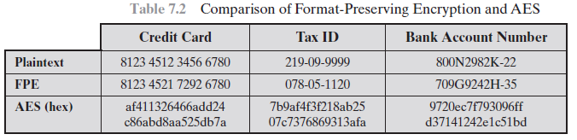
Format-Preserving Encryption (FPE)
Notes:
Format-preserving encryption (FPE) refers to any encryption technique that takes
a plaintext in a given format and produces a ciphertext in the same format. For
example, credit cards consist of 16 decimal digits. An FPE that can accept this type of
input would produce a ciphertext output of 16 decimal digits. Note that the ciphertext
need not be, and in fact is unlikely to be, a valid credit card number. But it will have
the same format and can be stored in the same way as credit card number plaintext.

Slide 42
Difficulties in Designing an FPE
A general-purpose standardized FPE should meet a number of requirements:
The ciphertext is of the same length and format as the plaintext
It should be adaptable to work with a variety of character and number types
It should work with variable plaintext length
Security strength should be comparable to that achieved with AES
Security should be strong even for very small plaintext lengths
Notes:
A general-purpose standardized FPE should meet a number of requirements:
1. The ciphertext is of the same length and format as the plaintext.
2. It should be adaptable to work with a variety of character and number types.
Examples include decimal digits, lowercase alphabetic characters, and the full
character set of a standard keyboard or international keyboard.
3. It should work with variable plaintext lengths.
4. Security strength should be comparable to that achieved with AES.
Security should be strong even for very small plaintext lengths.
Meeting the first requirement is not at all straightforward. As illustrated in
Table 7.2, a straightforward encryption with AES yields a 128-bit binary block that
does not resemble the required format. Also, a standard symmetric block cipher is
not easily adaptable to produce an FPE.

Slide 43
Padding
Needed when PT length is not multiples of the block size.
Several padding schemes exist, but care must be taken that the original length of the plaintext can be recovered.
The simplest is to add null bytes to the plaintext, which is a string containing no null bytes.

Slide 44
Padding
In DES method, padding is performed by adding a single one bit, followed by enough zero bits to fill out the block.
Schneier and Ferguson suggest two possibilities, both simple:
append a byte with value 128 (hex 80), followed by as many zero bytes as needed to fill the last block.
pad the last block with n bytes all with value n.

Slide 45
Padding
CFB, OFB and CTR modes can be performed without padding.
The last partial block of PT is XORed with the first few bytes of the last keystream block, producing a final CT block with the same size as the final partial PT block.
This characteristic makes them suitable for applications that require the encrypted CT to be the same size as the original PT.

Slide 46
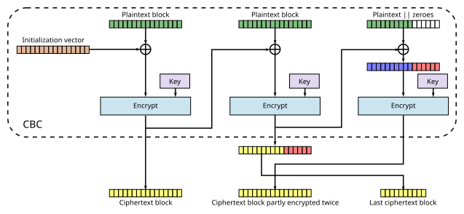
CBC with Ciphertext Stealing
Notes:
CBC ciphertext stealing encryption
Pad the last partial plaintext block with 0.
Encrypt the whole padded plaintext using the standard CBC mode.
Swap the last two ciphertext blocks.
Truncate the ciphertext to the length of the original plaintext.

Slide 47
Summary
Multiple encryption and triple DES
Double DES
Triple DES with two keys
Triple DES with three keys
Block cipher mode of operations
Electronic codebook
Cipher block chaining mode
Cipher feedback mode
Output feedback mode
Counter mode
XTS-AES mode for block-oriented storage devices
Tweakable block ciphers
Storage encryption requirements
Operation on a single block
Format-preserving encryption
Difficulties in designing
Padding
Notes:
Chapter 7 summary.

